Slide 1



AcF 304 Financial Markets
2023/24 Revision Session & Exam Structure

Slide 2
REVISION SESSION OUTLINE
Commercial Awareness – PMc
Summer Exam Structure – PMc
Weekly Module Topics – MB

Slide 3
Commercial Awareness
Worth approximately 20% of summer examination marks
If you are resitting the examination in June you will only be asked on CA topics covered last year

Slide 4
Key themes – Week 12
Interest rates / bond yields up / bond prices down
Why inflation & higher interest rates bad for stock market (and bonds)
How the FED makes decision and communicates
Market language – Dovish & Hawkish
Inflation up
NASDAQ fell more than S&P 500
End 2023 Fed ‘pivoted’

Slide 5
Key themes – Week 14
Non-Farm Payroll economic data release and affect on financial markets
Debt/GDP ratios - focus on Japan
GameStop +8000%
..including Payment For Order Flow

Slide 6
Key themes – Week 16
Classic portfolio theory was broken in 2022
Fixed Income Corporate Bond Liquidity Problem

Slide 7
Q Why is there a Corporate bond Liquidity Problem that didn’t exist before the 2008 financial crisis?
Corporate bonds > More instruments than stocks/FX– e.g. Toyota
Match buyers and Sellers? Banks need to hold on to Corp Inventory > Requires Capital.
Since 2008 banks have less capital & Basle 3 Reg means capital requirement has gone up.
Banks can’t hold endless amount Corp Bonds so limits trading bonds – Dealer 2 Client model is broken
All-to-All the solution?

Slide 8
Key themes – Week 18
Revision
What is the Yen Carry Trade?

Slide 9

AcF 304 Summer Examination
Near Top of Module Moodle Page

Slide 10
EXAM LAYOUT – There is a Mock Exam at top of module Moodle page
The exam consists of four sections:
Section A (28 marks): Twenty-eight multiple choice questions each worth 1 marks. Each question contains 4 possible answers A, B, C, D. There is no penalty for blank answers. No negative marking.
Section B (36 marks): Contains eight questions of which six need to be answered. Each question is worth 6 marks.
Section C (18 marks): Contains four questions of which three must be answered. Questions are worth 6 marks.
Section D (18 marks): Contains four questions of which three must be answered. Each question is worth 6 marks.

Slide 11
STYLE OF QUESTION
The exam consists of four sections:
Section A (28 marks): MCQ same style as End-term test BUT submitted as part of main paper not a dedicated Moodle MCQ test and broadly same difficultly as End Term Test. There will be a separate MCQ answer sheet. Be sure to write both your name and student number on both the MCQ answer sheet and exam answer booklet.
Section B (36 marks): Answer 6 from 8 questions: Explain concepts with many relating to the ‘real world’ .
With each question worth 6 marks we’re looking for a relatively substantial answer i.e. approx. 8 - 10 written lines making 6 or 7 points if possible. NOT bullet pointed.

Slide 12
STYLE OF QUESTION
The exam consists of four sections:
Section C (18 marks): Answer 3 from 4 questions. This section is fully Commercial Awareness focussed.
Instruction “In a paragraph of so answer 3 out of the 4 questions below:”
With each question worth 6 marks we’re looking for a relatively substantial answer i.e. approx. 8 - 10 written lines making 6 or 7 points if possible. NOT bullet pointed.
Section C is the significant change in the paper compared to previous years.

Slide 13
STYLE OF QUESTION
The exam consists of four sections:
Section D (18 marks): Answer 3 from 4 questions
Instruction “In a paragraph of so explain 3 out of the 4 terms and concepts below ”
With each question worth 6 marks we’re looking for a relatively substantial answer i.e. approx. 8 - 10 written lines making 6 or 7 points if possible. Two paragraphs or so. NOT bullet pointed.

Slide 14
SECTION A (30 marks)
Section A consists of 30 MCQ (Multiple Choice Questions) worth 1 mark each.
Answer all questions. Choose only one answer for each question.
Two or more answers provided, illegible answers, are considered as incorrect answers.
There are no marks deducted for an incorrect answer.
1) Suppose NetCorp Inc. was trading at $18.50 per share. At that time it pays an annual dividend of $0.82 per share, and analysts have set a 1-year target price of $26.00 per share.What is the expected return on the stock?
A) 44.97%
B) 40.54%
C) 43.24%.
D) 42.24%

Slide 15
Section B (36 marks)
Answer only 6 out of 8 questions.
6 marks per question
e.g.
1) What are ‘Closet Index Funds’ and why are they a concern for regulators?

Slide 16
Section B (36 marks)
Answer only 6 out of 8 questions.
6 marks per question
8)What does it mean when a bond is referred to as a convertible bond?Would a convertible bond be more or less attractive to a bond holder than a non-convertible bond?
Convertible bonds are bonds that may be exchanged for another security of the issuing firm such as common stock at the discretion of the bond holder. 1 mark If the market value of the securities the bond holder receives with the conversion exceeds the market value of the bonds, the bond holder will return the bonds to the issuer in exchange for the new securities and make a profit. 1 mark If the price of the underlying equity goes up, ‘all other things being equal’, the price of the convertible bond will also increase. 1 mark Convertible bonds gives investors an investment opportunity that is not available with non-convertible bonds in allowing bondholders to gain exposure to equity investments. 1 mark As a result, the yield on a convertible bond is lower than a non-convertible bond. 1 mark A Fixed Income Fund Manager may or may not have the authority to buy such bonds. 1 mark

Slide 17
Section C (18 marks)
THIS SECTION IS NEW AND FULLY COMMERCIAL AWARENESS FOCUSSED ( PMc Lectures)
Answer 3 out of 4 questions
Instruction “In a paragraph of so answer 3 out of the 4 questions below:”

Slide 18
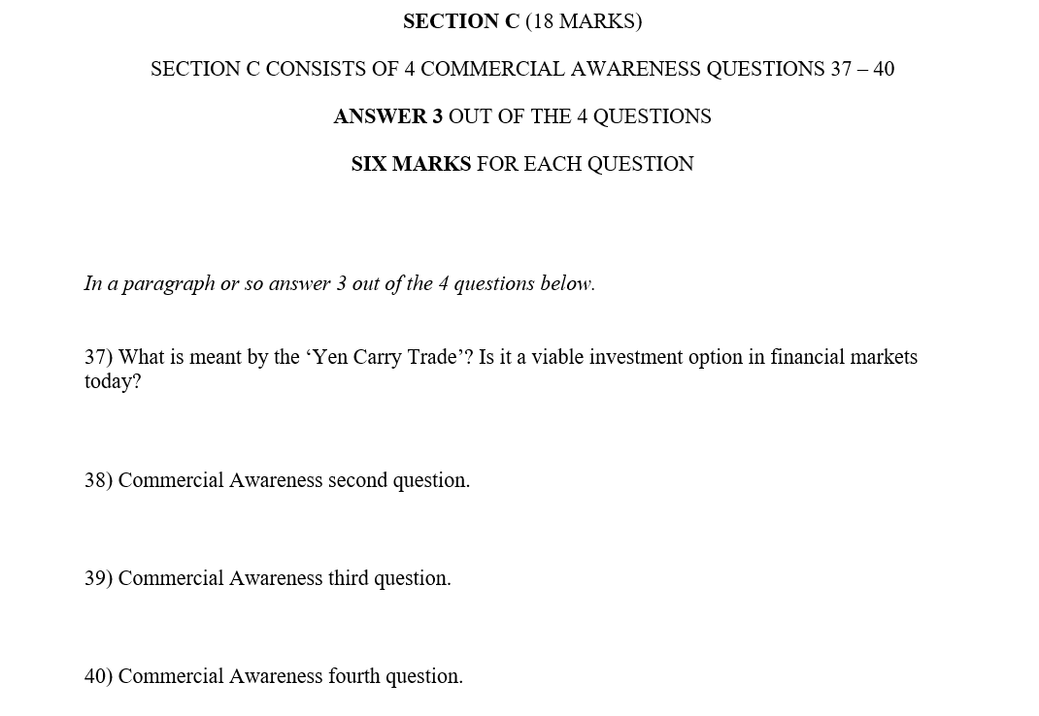

Slide 19
With each question worth 6 marks we’re looking for a relatively substantial answer i.e. approx. 8 - 10 written lines making 6 or 7 points if possible. Two paragraphs or so. NOT bullet pointed.
Same format for Sections B, C and D

Slide 20
Section D (18 marks)
Answer 3 out of 4 questions
Instruction “In a paragraph of so explain 3 out of the 4 terms and concepts below ”
Fixed Income Liquidity Risk and implications for investors.
ONE PARAGRAPH
It is the risk that an investor will have to sell the bond below its market value. 1 mark
The primary measure of liquidity is the size of the bid-offer spread. 1 mark Corporate Bonds are more likely to be more illiquid than Government Bonds. 1 mark
ONE PARAGRAPH
Investors dealing in large size trades may be more attracted to Government bonds than Corporate bonds due to the larger size and more liquid Government bond issues. 1 mark .
Since Govt bonds are more liquid than Corporate bonds, investors will find it easier to trade Govt bonds electronically 1 mark Even with Corporate Bonds investors will choose larger size issues rather than smaller size issues due to the better liquidity they offer 1 mark
With each question worth 6 marks we’re looking for a relatively substantial answer i.e. approx. 8 - 10 written lines making 6 or 7 points if possible. Two paragraphs or so. NOT bullet pointed.

Slide 21
Section B, C and D (6 mark questions)
Define any concept asked about
Give an example
If there is a question about Floating Rate Notes
a) Define what they are e.g A Floating Rate Note has a variable coupon…
b) Give an example how the coupon works e.g. if the FRN pays 6-month $ LIBOR +1% and LIBOR is 2% the coupon payment will be 3% until the coupon resets in 6 months time.
…then go on to answer the question being asked.
Give me us an excuse to give you marks!

Slide 22
Time
Allocation important
Section A – 28 marks
Section B – 36 marks
Section C – 18 marks
Section D – 18 marks
It quite a lot of material to get through!

Slide 23
AcF 304 Summer Examination
Near Top of Module Moodle Page

Slide 24

AcF 304 Summer Examination
Near Top of Module Moodle Page

Slide 25
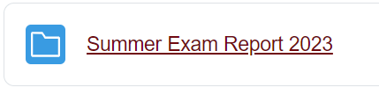
AcF 304 Summer Examination
Near Top of Module Moodle Page
Ignore any comments relating to Section C as Section C content has changed to Commercial Awareness questions this year.

Slide 26
REVISION SESSION OUTLINE
Commercial Awareness – PMc – Done
Summer Exam Structure – PMc – Done
Good Luck!!
Weekly Module Topics – MB

Slide 27
OUTLINE
1. Financial Markets and Financial System Overview
2a. Term Structure of Interest Rates
2b. Bond Markets
3. The Foreign Exchange Market
4. Money Markets
5. Why Do Financial Crises Occur and Why Are They So Damaging to the Economy – Part 1
6. Why Do Financial Crises Occur and Why Are They So Damaging to the Economy – Part 2
7. Central Banks & Conduct of Monetary Policy
8. The Stock Market
9a. Investment Management Trends & Challenges
9b. Commodities
10. Financial Derivatives

Slide 28
1. Financial Markets and Financial System Overview
Function of Financial Markets
Structure of Financial Markets
Internationalisation of Financial Markets
Function of Financial Intermediaries: Indirect Finance
Notes:
1.Channels funds from person or business without investment opportunities (i.e., “Lender-Savers”) to one who has them (i.e., “Borrower-Spenders”)
Improves economic efficiency
The importance of Direct versus Indirect Finance.
2.Introduced Debt Markets (Short/Medium/Long) – Equity Markets
Primary Markets & Secondary Markets
Exchanges and OTC markets
3. Foreign Stock Markets
Foreign Bonds and Eurobonds.
4.Role of Financial Intermediaries- transactions costs, risk sharing, and asymmetric information
Asymetric information involving Adverse Selection and Moral Hazard.
Buy Side/Sell Side/role of Investment Banks

Slide 29
2a. Term Structure of Interest Rates
Risk Structure of Interest Rates i.e. Default /Liquidity risk
Credit Ratings
Yield Curve
Expectations/Liquidity Premium/Market Segmentation theories

Slide 30
2b. Bond Markets
Purpose of the Capital Market
Capital Market Participants
Types of Bonds: Treasury/Municipal/Corporate
Characteristics of Corporate Bonds
Financial Guarantees for Bonds
Finding the Value of Coupon Bonds

Slide 31
3. The Foreign Exchange Market
Basic theory behind Exchange Rates in the Short Run and Long Run
Spot, Forward Transactions & FX Swaps
Currency appreciation and depreciation and impact on imports/exports
Why FX exists – trade, hedge, speculate
Spot quotation methods
Identifying the best spot price

Slide 32
4. Money Markets
Definition (Short-Term)
T-Bills, Commercial Paper, REPO, ….
Calculating T-Bill Investment & Discount Rates
Eurocurrencies inc. Eurodollar Deposits
Deposit Bid & Offer Prices – identifying the best price

Slide 33
5. Why Do Financial Crises Occur and Why Are They So Damaging to the Economy – Part 1
Financial Crisis History
Dynamics of Financial Crises in Advanced Economies (Stage 1, 2 & 3)
Great Depression
Why did the 2008 financial crisis occur? Detoured into Mortgage Backed Securities
The European Sovereign Debt Crisis

Slide 34
6. Why Do Financial Crises Occur and Why Are They So Damaging to the Economy – Part 2
Covid-19 Financial Crisis
Regulatory Response to Financial Crisis – Dodd Frank / MiFID2 / Basel 3

Slide 35
7. Central Banks & Conduct of Monetary Policy
Central Banks
ECB and the Fed
The Price Stability Goal and other goals of monetary policy (Fed’s Dual Mandate) versus ECB sole mandate
FOMC Meetings.
How Fed Actions Affect Reserves in the Banking System inc. ‘Fed Funds’
The Market for Reserves and the Federal Funds Rate
Conventional Monetary Policy Tools (Open Market Operations, REPO, Discount Lending)
Nonconventional Monetary Policy Tools
Fed’s Balance Sheet

Slide 36
8. The Stock Market
Equities Long Term Performance
Investing in Stocks: How Stocks are Sold
Computing the Price of Common Stock (PEs) /Gordon Growth Model
Stock Market Indexes
Mechanics of an IPO
Equity IPO –Valuing Using Comparables
IPO Underpricing & ‘Money Left On The Table’

Slide 37
9a. Investment Management Trends & Challenges
Growth of Investment Management
Active vs Passive Investment
Exchange Traded Funds
‘Closet’ Index Funds
Fees
Regulation
FinTech – Robo Advisors & Blockchain

Slide 38
9b. Commodities
1. OIL
OPEC and its role
Fracking
Covid-19
2. GOLD
‘Safe Haven’ investment
How Gold behaved in 2020 crisis
Gold and $ - why an inverse price relationship

Slide 39
10. Financial Derivatives
Hedging (Long/Short trading positions)
Forward Markets (normally FX!)
Financial Futures Markets
Marked-to-Market
Interest Rate Swaps (Mechanics, Motivations)
Credit Default Swaps (Protection Buyer/Seller, Recovery Rate)

Slide 40
BEST OF LUCK!
*These slides will be put on Moodle

